Slide 1
Advancements In Music Mood Classification Machine Learning Techniques For Mood Analysis
PRESENTED BY
Under the Guidance of
Mr. A. ANAND
Asst. Professor
VIJAYASRI JUNNU 21S11A05C6
KEERTHANA JUMBARATH 21S11A0583
VARSHINI VASAM 21S11A05C3
SANDEEP KAMSALI 21S11A05A3

Slide 2

ADVANCEMENTS IN MUSIC MOOD CLASSIFICATION MACHINE LEARNING TECHNIQUES FOR MOOD ANALYSIS

Slide 3
ABSTRACT
Most of the existing music recommendation systems use collaborative or content based recommendation engines. However, the music choice of a user is not only dependent to the historical preferences or music contents. But also dependent to the mood of that user. An emotion based music recommendation framework that learns the emotion of a user from the signals obtained via images. We are using images with faces to detect user mood and to recommend music. As faces are the best option to predict mood of the users. We tried a lot to search sensors data to classify mood but on internet no such datasets are available. In this application uploading images and detecting the emotion of the user.

Slide 4
EXISTING SYSTEM
Most of the existing music recommendation systems use collaborative or content based recommendation engines. However, the music choice of a user is not only dependent to the historical preferences or music contents. But also dependent to the mood of that user.

Slide 5
DISADVANTAGES
User is not only dependent to the historical preferences or music contents But also dependent to the mood of that user.
Choice is depend various factors.

Slide 6
PROPOSED SYSTEM
It proposes an emotion based music recommendation framework that learns the emotion of a user from the signals obtained via images. We are using images with faces to detect user mood and to recommend music. As faces are the best option to predict mood of the users. We tried a lot to search sensors data to classify mood but on internet no such datasets are available. Uploading image and then using python OPENCV and pre-processing image to extract features and then this features is applied on SVM/Deep Learning Neural Network Training Model to predict moods of user and based on user mood all songs will be detected and shown in drop down box and user can select any song and play. The results of comprehensive experiments on real data confirm the accuracy of the proposed emotion classification system that can be integrated to any recommendation engine.

Slide 7

ADAVANTAGES
The emotion of a user from the signals obtained via faces in images.
Experiments on real data confirm the accuracy of the proposed emotion classification system that can be integrated to any recommendation engine.

Slide 8
SYSTEM REQUIREMENTS
SOFTWARE REQUIREMENTS:
Coding language : Python.
Version : 3.7.1.
Libraries : Open-CV, keras, NumPy.
HARDWARE REQUIREMENTS:
System : Intel Core i5.
Hard Disk : 500GB.
RAM : 16GB.

Slide 9

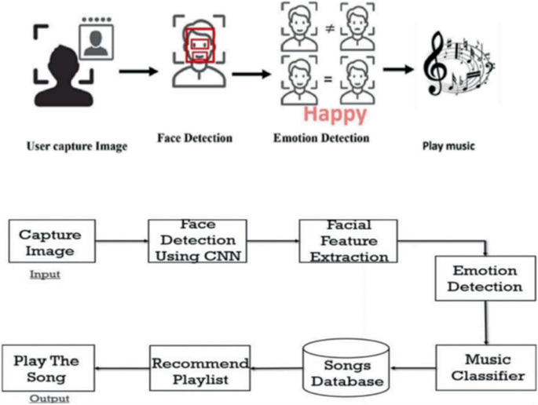
SYSTEM ARCHITECTURE

Slide 10
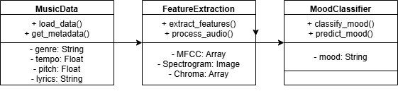
UML DIAGRAMS
Fig: Class Diagram

Slide 11
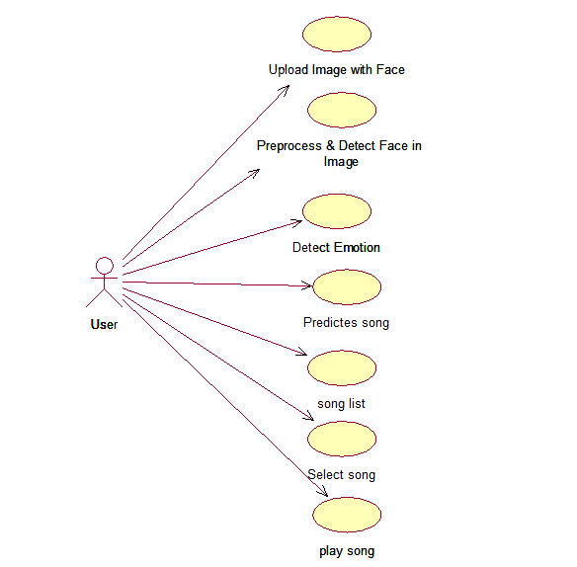
Fig: Use case Diagram

Slide 12
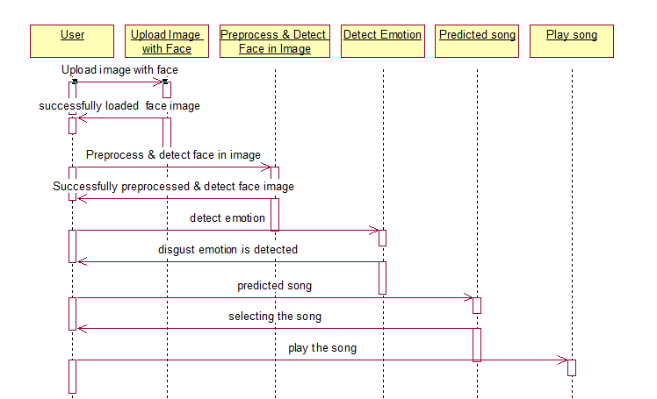
Fig: Sequence Diagram

Slide 13
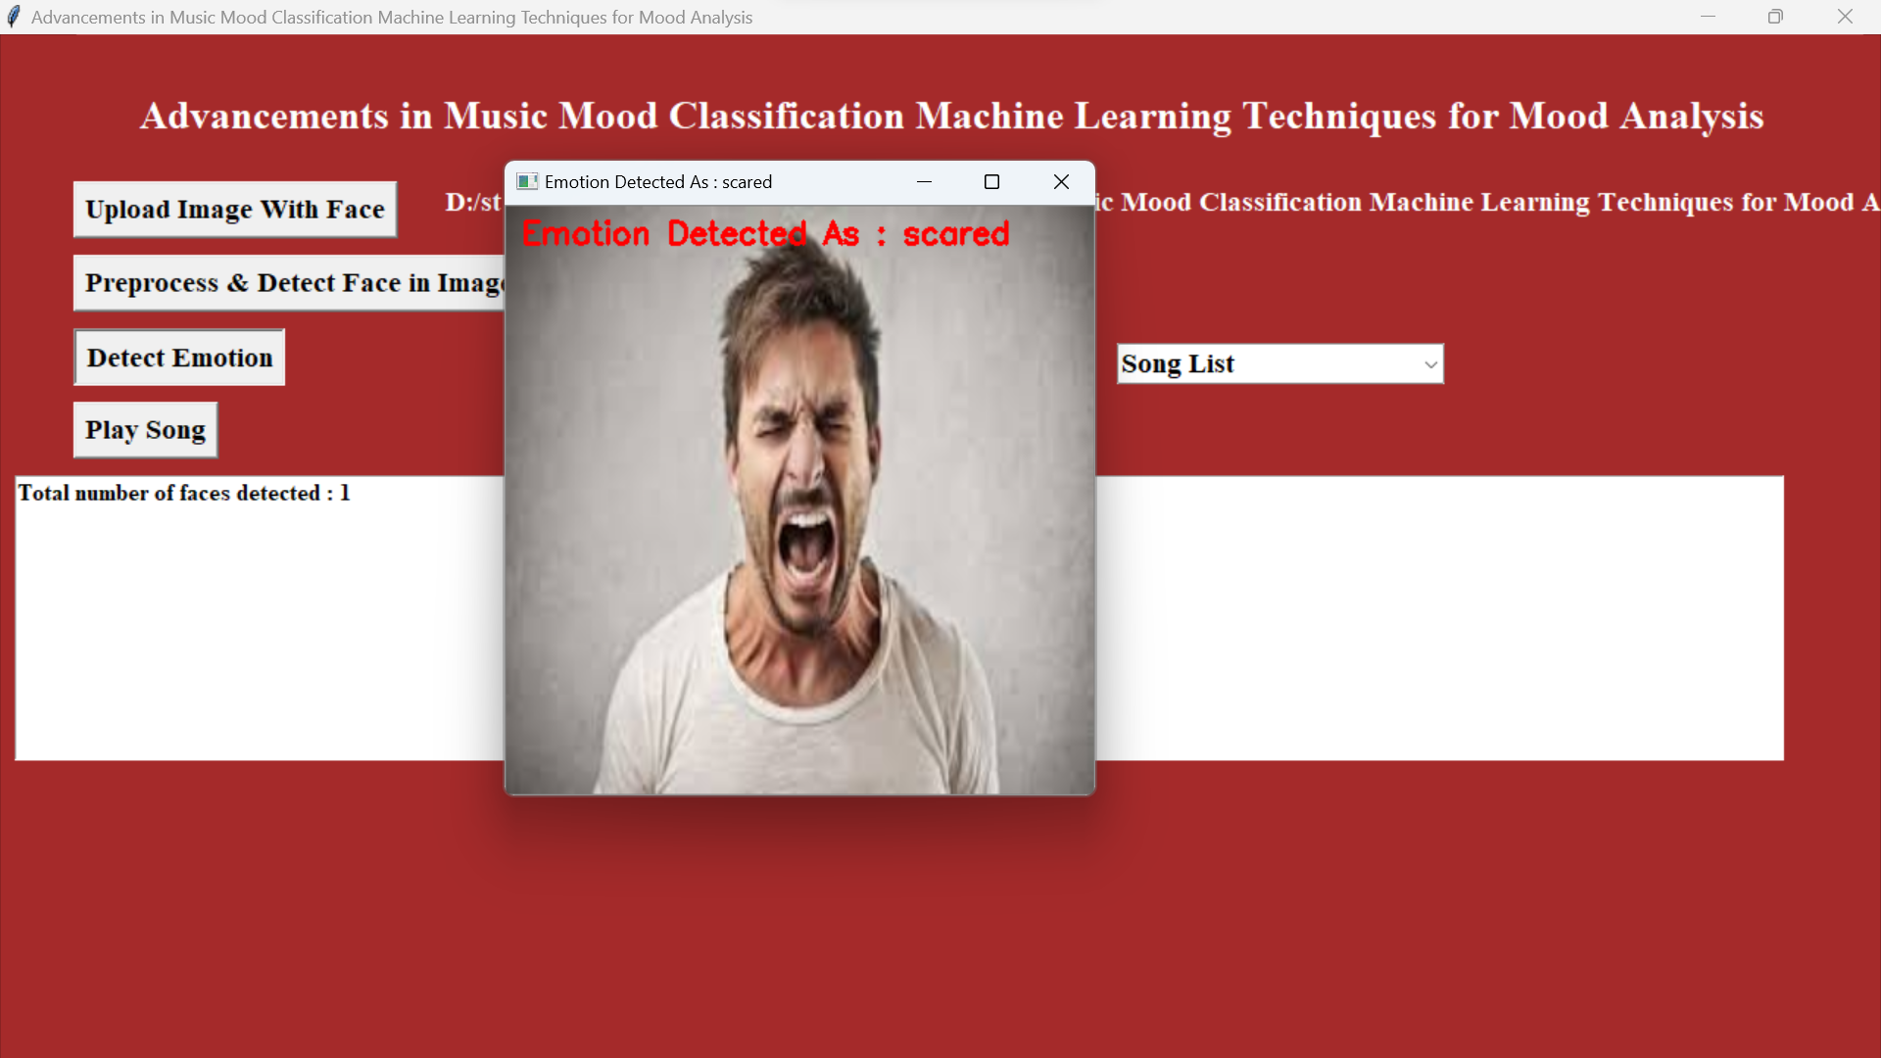
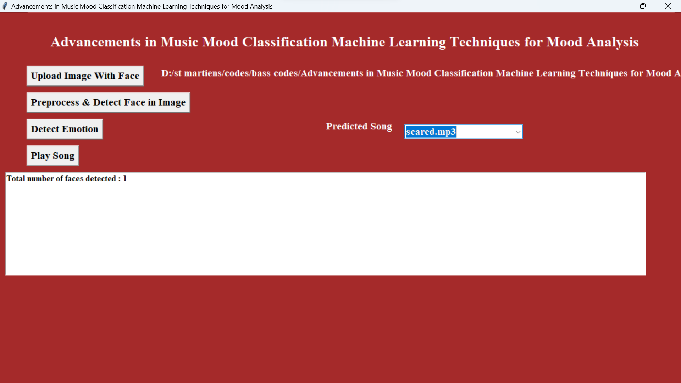
OUTPUT SCREEN

Slide 14
CONCLUSION
A framework has been proposed to enhance music recommendation systems using physiological signals, particularly facial expressions. Since facial images are effective for emotion detection, the system uses OpenCV and preprocessing to extract features from uploaded user images. These features are fed into an SVM or deep learning model to classify the user's mood. Based on the detected emotion, relevant songs are recommended via a dropdown list. The user can then select and play a song. Efforts to use sensor data for mood detection were limited due to a lack of publicly available datasets. Experimental results confirm the system’s accuracy, making it suitable for integration with recommendation engines.

Slide 15
THANK YOU

